Slide 1




Example Company-Price/Volume/Mix (FY25 Review)

Slide 2
Executive Summary
GM decreased YoY -$288K
-$569K was due to decline in volume
Offset by +$288K increase due to a favorable mix

Slide 3
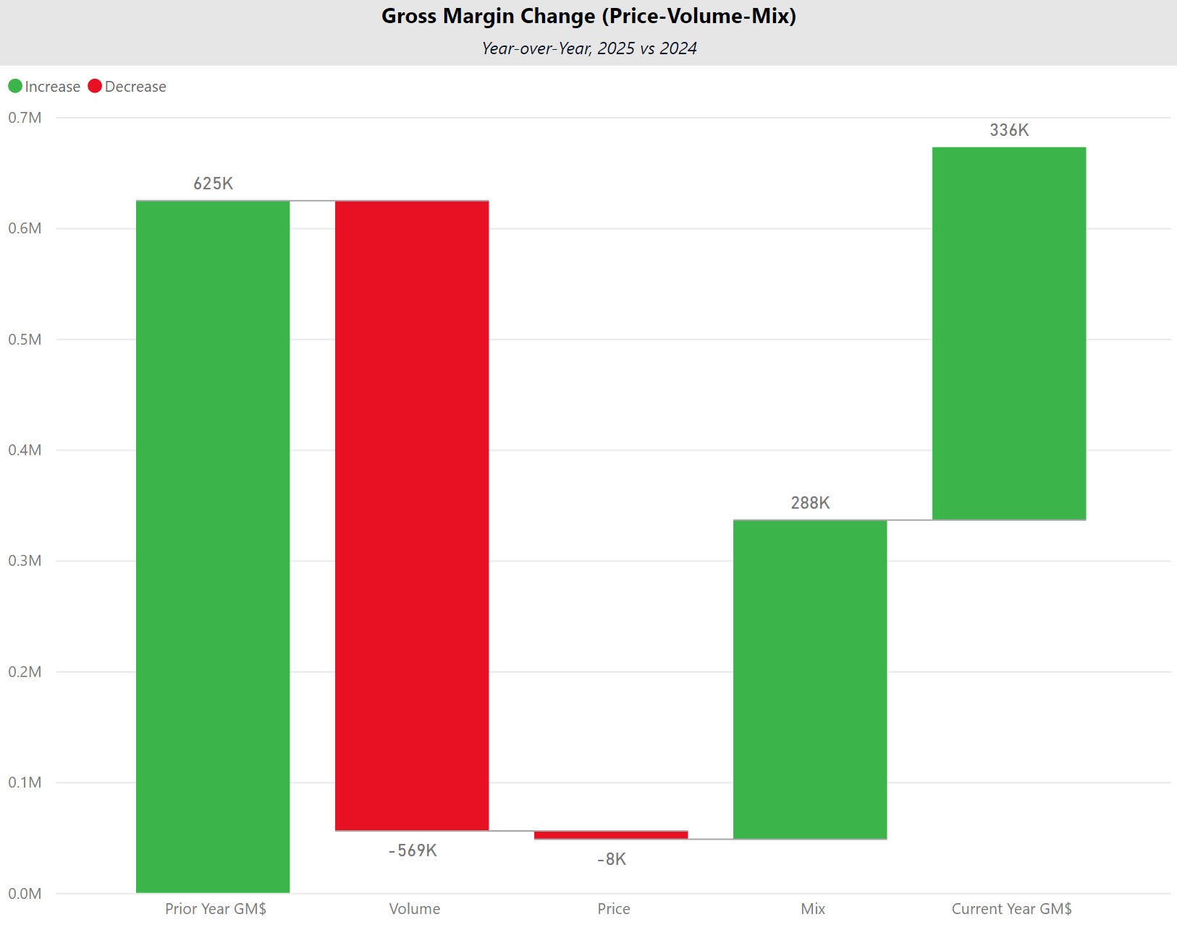
Price–Volume–Mix Analysis
Notes:
pivotTable
No alt text provided
Gross Margin Change (Price-Volume-Mix)
No alt text provided
textbox
No alt text provided

Slide 4


Next Steps
Investigate the prices from vendor Zenex that need to be increased and find out the explanation for the overall decrease in volume across all vendors YoY.

